Slide 1

Following Jesus together across barriers
SAVE THE DATE
5-10 July 2022
mwc-cmm.org
Assembly 17 in Indonesia is welcoming 700 participants.
Online Participants will experience local congregations throughout all activities including hybrid plenary sessions, workshops, a virtual art exhibit, the Youth Program and more.
Salatiga will be the host city and the Sangkakala Seminary (STT) will host the plennary sessions.
We will have satellite meeting places at four local congregations and will live stream our evening speakers from there, while the international choir will sing with us at STT.
Notes:
Staying true to God’s word.
Witnessing to a changing world.
Pursuing peace and justice.
Building bridges.
Becoming better stewards.
Finding unity in diversity.
Whatever our reality, we are called to follow Jesus across barriers.
We are not meant to walk this journey alone. This is why Mennonite World Conference hosts an Assembly every six years, providing a space for Anabaptists-Mennonites to learn God’s truth, worship as one, share experiences, build relationships, and serve together.
Make plans to come in person or virtually!
5-10 July 2022
Semarang, Indonesia
More info: mwc-cmm.org

Slide 2
Welcoming the Anabaptist family, online and on-site
Today, in Indonesia, there are...
approximately 108 000 Mennonites
582 Mennonite congregations
Three national churches, or synods: GITJ, GKMI, JKI
Make plans to
come in person or virtually!
5-10 July 2022
Central Java, Indonesia
More info: mwc-cmm.org

Slide 3
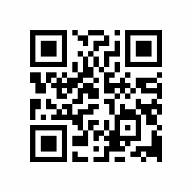
Please register early!
Make sure that you can celebrate Indonesia 2022 online and/or on-site.
Registration is available.
Register now!
SAVE THE DATE
5-10 July 2022​
More information: indonesia2022.mwc-cmm.org​​

